Slide 1
Project Management:
Process, Technology, and Practice
Ganesh Vaidyanathan
Chapter 7
Quality and Performance

Slide 2
Learning objectives
Manage project quality and quality as seen by quality gurus
Determine how performance in projects are measured
Define cost of quality
Implement quality planning, assurance, and control in projects
Measure project value, project performance, and project scope

Slide 3
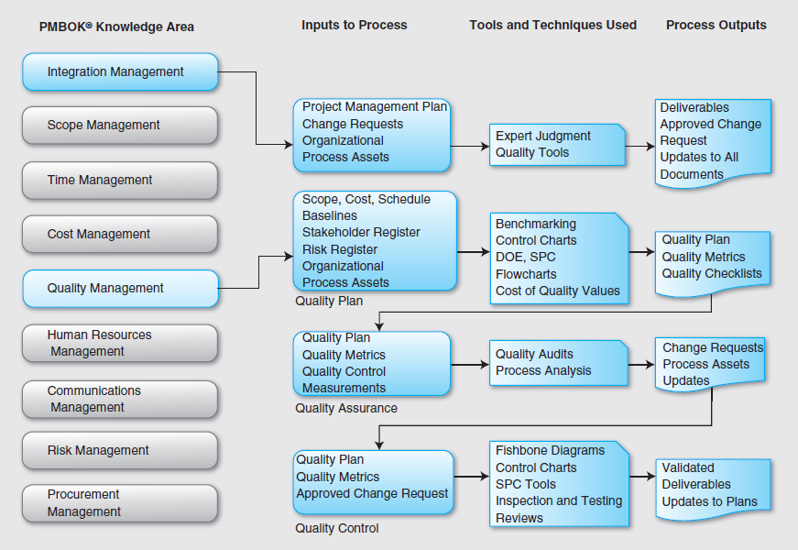

Slide 4
Performance and Quality
Performance is the execution or accomplishment of a project to fulfill customer requirements in accordance with the project scope.
Project quality is the degree to which a set of inherent characteristics of a project fulfills project scope.
Quality has become the focus point of performance.

Slide 5
Quality
Performance refers to the superiority or excellence of primary operating characteristics of a product
Example: Low miles-per-gallon ratio, acceleration, and other functioning (running, operation, working, action, behavior, capacity, efficiency, and capabilities) in cars
Features are defined as the availability and excellence of “bells and whistles” related to a product.
Example: Heated seats in winter, large trunk space, and so on

Slide 6
Quality
Reliability is defined as the extent to which a product is not likely to fail or break down.
Example: The reliability of cars is often measured by how many problems the owner has with a particular product and how severe the problems are.
Conformance is concerned with the extent to which a product’s design and operating characteristics meet predetermined technical standards.
Example: Emission control in the United States is a predetermined standard that needs to be implemented regardless of where the car was manufactured and bought.

Slide 7
Quality
Durability is concerned with the physical life of a product.
Example: Durability of tires
Serviceability indicates the extent to which a product can be easily adequately repaired and serviced.
Example: How accessible are battery, spark plugs, and other easily maintainable parts

Slide 8
Quality
Aesthetics refers to the look, feel, taste, smell, style, and/or fashion of a product,
Example: Style and look of the exterior and interior of cars
Image indicates the extent to which a product conveys an upscale or sophisticated image.
Example: Buyers of BMWs and other luxury cars display an affluent image.

Slide 9
Quality
Dimension | Description | Example: New Product Project Printer | Example: Service MIS projects for Bank
Performance | Primary characteristics | Pages per minute | Time to process customer checks
Features | Secondary characteristics | Multiple paper trays | Automated bill pay
Reliability | Consistency of performance over time | Average uptime per year | Average number of processed check mistakes per year
Durability | Useful life | Expected life of major components | Expected life of systems with respect to technology

Slide 10
Quality
Dimension | Description | Example: New Product Project Printer | Example: Service MIS projects for Bank
Serviceability | Ease of repair | Number of copies per print cartridge | Ease of obtaining information
Aesthetics | Sound, looks, etc. | Looks; sound | Courtesy of teller
Conformance | Conformance to specifications | IEEE specifications | Fed Reserve Specifications
Perceived quality | Reputation on past performance | Brand name recognition | Customer service recognition

Slide 11
Quality Management
Quality Management is composed of:
quality planning
quality assurance, and
quality control.
Quality is meeting or exceeding customer expectations.
Components of quality management:
Customer satisfaction
Defect prevention
Continuous improvement
Management responsibility to provide essential resources
Defect vs. Defective

Slide 12
Standards and Quality - ISO
ISO (International Organization for Standardization)
Is the world’s largest developer and publisher of international standards .
A network of the national standards institutes of 162 countries, one member per country, with a central secretariat in Geneva, Switzerland, that coordinates the system.
Is a non-governmental organization that forms a bridge between the public and private sectors.

Slide 13
Standards and Quality - ISO
The ISO 9000 family of standards
Addresses quality management to help organizations fulfill the quality requirements of the customer with applicable regulatory requirements.
Represents an international consensus on good quality management practices and consists of standards and guidelines relating to quality management systems and related supporting standards.

Slide 14
ISO
Version | Description
ISO 9000 | Defines the fundamentals of quality management systems and includes eight management principles
ISO 9001 | Deals with the requirements that an organization has to fulfill in order to meet the standards and provide a model for quality assurance in design, development, production, installation, and servicing for creation of new products, services, and systems.
ISO 9002 | Provides a model for quality assurance in production, installation, and servicing.
ISO 9003 | Provides a model for quality assurance in final inspection and testing.
ISO 9004 | Emphasizes quality assurance via preventive actions instead of just checking final product, system or service.

Slide 15
ISO
Version | Description
ISO 9000-2005 | Quality management systems – Fundamentals and vocabulary
ISO 9001:2008 | Quality management systems – Requirements
ISO 9004:2000 | Quality management systems – Guidelines for performance improvements
ISO 10006:2003 | Quality management – Guidelines for quality management in projects
ISO 10007:2003 | Quality management – Guidelines for configuration management
ISO 10012:2003 | Measurement management systems – Requirements for measurement processes and measuring equipment
ISO/TR 10013:2001 | Guidelines for quality management system documentation
ISO 10019:2005 | Guidelines for the selection of quality management system consultants and use of their services

Slide 16

Malcolm Baldrige Award
Criteria for performance excellence are based on seven categories:
Senior leadership guidance, the governance system, the approach to leadership improvement, and how organizations ensure ethical and societal responsibilities
Establishing, implementing, and leveraging organizational strategic planning
Listening to and getting information from customers and engagement with customers to serve their needs and build relationships

Slide 17
Malcolm Baldrige Award
Organizational measures, analysis, and improvement of performance and the management of information, organizational knowledge, and information technology
Building an effective and supportive workforce environment and how organizations engage its workforce to achieve organizational and personal success
Design, management, and improvement of work systems and key work processes
Results of product performance and process effectiveness, customer-focused performance, workforce-focused performance, senior leadership and governance, and financial and market results

Slide 18
Quality Planning
Project quality planning is a process for identifying quality standards and requirements for the overall project and for tracking, monitoring, and managing the expectations of planned quality.
The inputs for quality planning include the scope document, the requirements from stakeholders, the risk register, and the project schedule.
By using this input information, a project manager in cooperation with the quality team can develop a quality plan for a project.
The inputs for the quality planning are the scope document, the requirements from stakeholders, the risk register, and the project schedule.

Slide 19
Quality Planning
Developing a Project Quality Plan:
Step 1: Gather Input Data
Collect information from the scope document, the requirements from stakeholders, the risk register, and the project schedule
Step 2: Analyze Data
Using the cost-benefit analysis that was completed during project initiation, a project quality management team can develop quality planning activities intended to meet quality requirements.

Slide 20
Quality Planning
Step 3: Set Quality Metrics
After the quality planning activities are approved, quality metrics should be identified and selected.
The quality team has to select specific metrics to be used in quality assurance and quality control activities.
Step 4: Develop Improvement Plan
A project quality plan should include an improvement plan.
It should detail activities in order to analyze quality performance during the progress of a project and identify actions needed to enhance its value.

Slide 21
Quality Planning
The improvement plan should include the following activities:
The most appropriate methods of quality tests, inspections, and reviews
The best period to carry out such quality checks; and
The people to be involved in the quality checks.

Slide 22
Quality Planning
Benchmarking – A Quality Planning Tool
Benchmarking is a process to measure the performance of an organization and compare that measure with other organizations in the same industry to understand industry best practices.
Benchmarking identifies the best practices of other successful projects.
The goal of the benchmarking process is not to compare projects or organizations of competitors but to actually understand the best practices of other similar projects.

Slide 23
Quality Planning
It is a way of seeking superior process performance by looking outside an organization, not a process for copying the practices of competitors.
The term benchmark refers to a reference point against which performance is measured that is the indicator of achievement.

Slide 24
Quality Assurance and Control
Quality assurance (QA) is a process used to evaluate project performance periodically and ensure that the project will satisfy the quality standards of an organization.
The inputs for quality assurance are quality planning, work performance information, quality control measurements, and quality metrics.
The outputs of the process are asset updates, change requests, project management plan updates, and project document updates.
Quality assurance is accomplished by quality audits, process analysis, and tools and techniques used in quality control.

Slide 25
Quality Assurance and Control
Quality Audits
A quality audit is a review of the quality plan to determine whether the project activities comply with organizational and project policies, processes, and procedures.
A Quality Audit needs to:
Identify all the best practices of the project.
Identify all the limitations of the project.
Identify all the problems in the project.
Identify the best practices and disseminate them to other projects as and when necessary.
The Quality Auditor:
Helps the project by providing positive criticism towards the implementation of project.
Provides positive influence on project processes.
Stores the contributions of each audit in the lessons learned knowledge management system.

Slide 26
Quality Assurance and Control: Audit Report
Audit Date | Planned/ Unplanned Audits | Number of Non-Compliant Issues |  | Number of Actions Taken on Non-Compliant Issues |  | # of High-Priority Risk Items in Project Risk List | Hours to Prepare and Conduct the Audit | Auditor
5/12 | Planned | 1 | 4 | 0 | 1 | 1 | 12 | GV
6/2 | Planned | 2 | 3 | 0 | 0 | 2 | 24 | GV
3/2 | Unplanned | 2 | 3 | 0 | 0 | 1 | 15 | GV

Slide 27
Quality Assurance and Control: QPA
Quality process analysis (QPA) follows all the steps outlined in the process improvement plan in order to identify the improvements necessary to enhance the quality of a project.
QPA is a basic technique that may help set new directions and define indicators to chart systematic continuous improvements in projects.
QPA can be accomplished using the cause-and-effect diagram technique.

Slide 28
Quality Assurance and Control: QPA
QPA consists of eight distinct steps:
Establish a mission statement
Describe and prioritize accountabilities
Describe and analyze processes
Determine customer requirements
Build in customer requirements
Document processes
Establish performance monitoring
Improve

Slide 29
Quality Control
Quality control (QC) is the operational technique and activity used to fulfill quality requirements.
QC is used to verify whether project outcomes meet acceptable quality, reflect the project scope, and satisfy stakeholders.
Tools and techniques used in QC:
Cause and effect diagrams
Run charts
Scatter diagrams
Histograms

Slide 30
Quality Control
More tools:
Pareto charts
Six sigma
Process maps or Flowcharts
Control charts
Statistical sampling
Reviews
Testing and Inspection

Slide 31
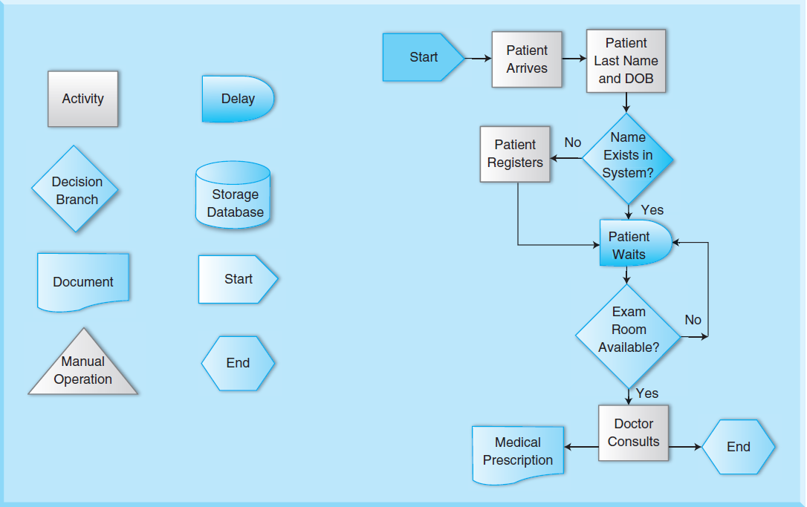
Process Maps and Flow Charts

Slide 32
Statistical Process Control
Statistical process control (SPC) is an application of statistical methods to monitor and control a process in order to reduce variability.
SPC helps a process to conform to project scope and quality specifications with the least possible waste.
SPC can lead to reducing waste and the time required to produce the product or service from end to end.
Using SPC, it is possible to identify bottlenecks, wait times, and other sources of delay within a process.
Many organizations have enjoyed process cycle time reductions as well as cost reductions using SPC.

Slide 33
Statistical Process Control
An SPC control chart is a tool used to determine whether a project or a business process is in a state of statistical control
It plots measurements or test outcomes against time.
The use of control charts is a preventive method to manage quality by monitoring processes in a way that identifies potential problems before defects are even created.
There are four different control charts used in controlling quality:
X-bar charts; R-charts; P-charts; and C-charts.

Slide 34
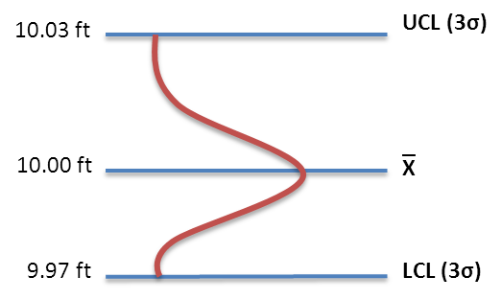
X-Bar Charts
EPC, Inc. manufactures 10ft 18 AWG computer power extension cords. The process standard deviation is 0.1 feet. After manufacturing 25 cords for a project, each data point is plotted on the X-bar chart.
Using Equations 7-2 and 7-3, we obtain,
UCL = = 10 + (z* 0.1/5). If z = 3-sigma, UCL = 10.06
LCL = = 10 - (z* 0.1/5). If z = 3-sigma, UCL = 9.94

Slide 35
X – Bar charts
Instead of the standard deviation, let us use an average range of the sample equal to 0.8 feet. In this case, using equations 7-4 and 7-5, we get,
UCL = = 10 + (0.15 x 0.8) = 10.12
LCL = = 10 - (0.15 x 0.8) = 9.88

Slide 36
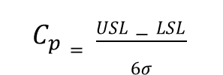
=
R Charts
For Examples 7-4, the average range of the samples was calculated as:
= = 0.48
For the 25 observations, D₃ = 0.46 and D₄ = 1.54.
Using Equations 7-7 and 7-8, we can compute the UCL and LCL as:
UCL = x D₄ = 0.48*1.54 = 0.74 feet
LC L = x D₃ = 0.48*0.46 = 0.22 feet
The chart is shown to the right:
UCL
Process Capability:
R
LCL

Slide 37
Process Capability
Process capability is a critical aspect of quality control and evaluates the ability of a project process to meet or exceed the expectations or preset specifications
For a product, a system, or a structure to be acceptable by customers and end users, its characteristics must fall within a preset range of the specifications.
The specifications, or tolerance limits, are usually established by design engineers or product design specialists.
Process capability involves evaluating process variability relative to preset specifications in order to determine whether the process is capable of producing, building, or implementing an acceptable product, service, structure, or system.

Slide 38
Design of Experiments (DOE)
Design of experiments (DOE) is a statistical method for identifying which factors influence specific variables of a product or process and which variable has the greatest effect.
DOE is used to determine the number and types of tests and their impact on cost of quality.
If a project has two variables, for example, cost and technology, and if choosing a particular technology affects the cost of a project, the DOE method can be employed to find the relationship between technology implementation (x-variable) and cost (y-variable).

Slide 39
Uses of DOE
Comparing alternatives and results to select the best option; for example, making an informed decision on a technology solution that evaluates both quality and cost
Identifying the significant input factors that affect an output or response; for example, identifying the other significant factors beyond technology
Achieving an optimal process output or response; for example, identifying the important factors to achieve a website using .NET architecture
Reducing variability; for example, ensuring that when another technology is integrated with .NET architecture, the outcome remains the same

Slide 40
Uses of DOE
Minimizing, maximizing, or achieving a response or output; for example, identifying how .NET architecture can be made as scalable as possible
Improving project process; for example, identifying whether the project produces the same outcome if implemented in a different version of operating system or a totally different operating system
Balancing trade-offs; for example, identifying how to achieve technology goals with minimum resources

Slide 41
Design of Experiments (DOE)
7 Step Process
Step 1: Understand Inputs and Outputs
Step 2: Measure Responses Quantitatively
Step 3: Create a Factor Matrix
Step 4: Create High and Low Levels
Step 5: Complete Four Estimations
Step 6: Calculate Effects
Step 7: Confirm and Verify Results

Slide 42
Statistical Sampling
Statistical sampling deals with the selection of a subset of a population in order to gain knowledge about the whole population and to predict quality outcomes of the population using statistics.
A population is the number of items from which to draw a sample.
A sample is a selection of items from which any feature of the population may be estimated.
Sampling is the easier and cheaper choice with a simpler and smaller data set to work with. Because of the smaller size of the data set, it is possible to improve the accuracy and quality of the data.

Slide 43
Statistical Sampling
The size of a sample and the number of observations have to be determined first to conduct statistical sampling.
The sample size is an important feature and is determined based on the expense of data collection and the need to have sufficient statistical power.
For example, in a census project, data are collected on the entire population and the sample size is equal to the population size.
In a project involving experimental design, when the study is divided into different treatment groups, different sample sizes for each group have to be selected.

Slide 44
Statistical Sampling
Method | Definition | Uses | Limitations
Simple Random Sampling | Every member of the population is given an equal chance | Good estimates of the population and sampling error | Need complete and accurate population
Quota Sampling | The population is stratified by important variables, and the required quota is obtained from each stratum or level | Quick way to obtain a sample; economical | Knowledge of population is essential. Not random and therefore may be biased

Slide 45
Statistical Sampling
Method | Definition | Uses | Limitations
Cluster Sampling | A random sample of clusters is considered, and then all members within those clusters are examined | Quick and easy; does not require complete population information; works well when each cluster is part of the whole population | Larger sampling error; if clusters are big, becomes very expensive; larger sample size needed to compensate for greater sampling error

Slide 46
Statistical Sampling
Method | Definition | Uses | Limitations
Judgment sampling | Uses deliberate choices of information and excludes any random process | For small samples from a well-understood population | Prone to bias; because the sample is small, credibility problems will surface

Slide 47
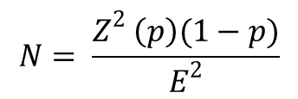
Random Sampling
In this method, each member of the population has an equal chance of being selected for the sample, which is 1/N. When the second member is selected, all the remaining (N-1) members of the population have 1/ (N-1) chance of selection.
In a project, if an inference about a population from a sample is needed, sample size is important. Larger sample sizes generally lead to increased precision. The sample size is determined by the following equation:
where n = sample size
Z = z-score associated with the required confidence level
p = occurrence rate within the population
E = required precision

Slide 48
Reviews
Expert reviews
Peer reviews
Team reviews
Walk-through reviews
Formal reviews
Management reviews
Process reviews

Slide 49
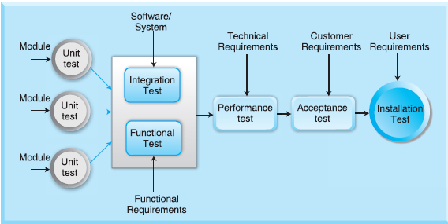
Testing
Testing is a primary function in software development projects and involves evaluating the results of a system or software application under controlled conditions.
During testing, testers intentionally attempt to break the software application or system to see if things can go wrong. This is done in order to determine if things happen when they shouldn’t or things don’t happen when they should.

Slide 50
Testing
Testing also involves monitoring and controlling the software application development process to ensure that standards and procedures are followed. Therefore, testing is oriented to detection and prevention.
A software bug is an error, flaw, or mistake in a system or software application.
These bugs lead to problems when systems or programs are executed.
They make the system or application result in incorrect or unexpected terminations or behave in unintended ways.

Slide 51
Testing
Most bugs arise from mistakes and errors made by programmers, and a few are caused by compilers producing incorrect code.
Other reasons that contribute to problems in software applications:
Change in requirements
Complexity of the software application
Schedule pressures
Poor documentation, especially in code
Wrong or misfit technology
Wrong software development tools

Slide 52
Inspection
An inspection is a formal evaluation involving measurements and tests.
The results of testing are usually compared to specified requirements and standards to determine whether the project activity, material, or entity is within those requirements and standards.
Inspections may be either planned or unplanned.
A software inspection consists of review practices in projects including code reviews and peer reviews.

Slide 53
Inspection
A code review is an inspection where the project team may examine a piece of software code and fix defects.
A defect is a software code that does not function as the programmer intended or that can be improved.
Peer reviews are conducted by a project team that inspects the software within a structured review process to evaluate the technical content and quality in a project.

Slide 54
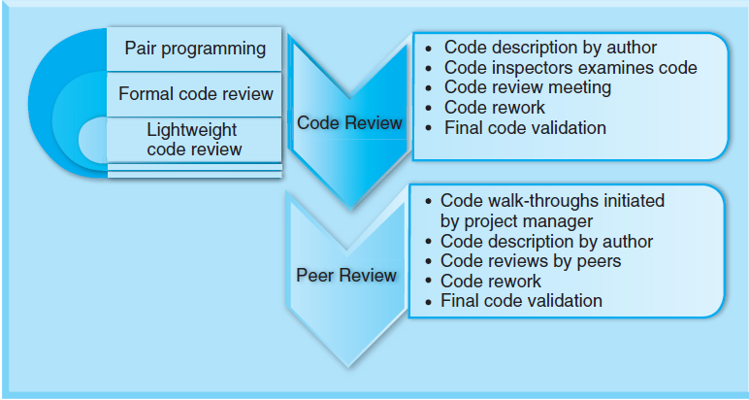
Inspection

Slide 55

Metrics
A metric is a measure of the activities of a project and specifically a measure of the final deliverables of a project.
The metrics must:
Provide information about the health of a project
Provide data for project control
Measure what is essential for project success
Be a part of the project process
Be used consistently in all projects
Be easy to collect and analyze
Be affordable and provide value

Slide 56
Summary
Project performance is of extreme importance to an organization as it specifies how well the project’s outcome performs against customer requirements and the intended use of the system, project, or service.
Quality is the focus point of performance in all projects; most companies view quality as a process, and continuously improving processes retain existing customers, win back lost customers, and win new customers.
Quality is a multi-faceted attribute that can be found in products and services and is defined as conformance to requirements.

Slide 57
Summary
The major goal of quality management is to prevent defects. Quality management eliminates the source of defects so that defect detection and rework are not encountered during projects.
A project organization must apply quality standards and quality management at three levels: organizational, process, and project.
Project managers should understand the processes, the inputs, and the effects on the performance of their projects.
The ISO 9000 family of standards represents an international consensus on good quality management practices and consists of standards and guidelines relating to quality management systems and related supporting standards.

Slide 58
Summary
Quality management is composed of quality planning, quality assurance, and quality control. Quality management is more about process and is based on problems related to processes. Quality planning identifies quality standards that are relevant to the project and determines how to use those standards in the planning of a project.
Quality assurance ensures that all planned activities of a project provide confidence to users, customers, and all other stakeholders by satisfying all required quality standards in a project.

Slide 59
Summary
Quality control monitors specific project results, determines whether they comply with relevant standards, and identifies ways to eliminate causes of unsatisfactory results. These three processes―planning, assurance, and control―interact with each other.
Quality control (QC) is the operational techniques and activities used to fulfill requirements for quality; there are many tools and techniques used in quality control, including cause-and-effect diagrams, run charts, scatter diagrams, histograms, Pareto charts, Six Sigma, process maps, control charts, statistical sampling, reviews, testing, and inspection.

Slide 60
Summary
A metric is a measure of the activities of a project and specifically a measure of the final deliverables of a project. The reason to measure project metrics is to determine the current state or “health” of a project.
Metrics provide important objective information on a project and can help the project be more successful with risk mitigation, project control, team performance, and customer satisfaction.

Slide 61
Class Discussions
What else may be considered for performance other than quality?
Do the three quality gurus preach the same message on quality?
Quality audits have to be performed on each project.
Is there one tool that may be used in all projects for quality control?
Can we do without metrics when managing projects?
There are differences between testing and inspection.
Who decides which metrics are the best for a project: the project manager or management?
Should management be involved in quality management?

Slide 62
